Slide 1




BANK LOAN PROPOSAL
Members:
David
Brendan
Phuong
Angela
Erastus
Dante

Slide 2
Machine Learning Project Outline
Our goal is to create a Machine Learning Model capable of assessing whether a loan application will be successful based on the applicants’ circumstances including “Income, Loan Amount, Credit Score and Property value”.
Various Machine learning algorithms were tested to pick the best performer.
The model is used in home loan application form which will provide application result under 60 seconds after submitted.
In addition, charts displaying various machine learning algorithm performances along with data comparisons are created.
Echart.JS, Jquery.js and Seaborn are used to develop the charts.
Our website was uploaded to Heroku and can be found at the following website https://mlforloan.herokuapp.com/

Slide 3




FUNCTIONALITY TABLE
Data Sourced and Cleaned
Database
Machine Learning Model
Testing and Selection
Flask
HTML Website
Loan Application Form
Data Comparison Charts
Heroku Upload

Slide 4


DATA
The dataset used in this project was sourced from Kaggle in a CSV Format
Data Cleaning was carried out in a Jupyter Notebook
DATA Pre-Processing
Feature selection
Removed rows with more than 3 Nan values and dropped duplicates
Used LabelEncoder to transform categorical variables to numerical values
Used KNNImputer to predict missing values in the dataset
Notes:
PROPOSAL INTRODUCTION

Slide 5
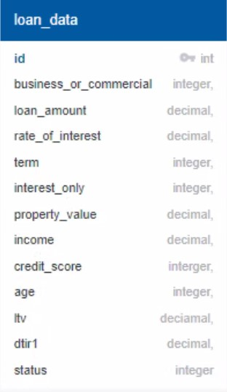

Database & Flask
This project used SQLite to store data: Reason for using SQLite as a database, the project required a relational database and a relatively low-traffic since we were running heavy machine learning algorithms, hence the use of SQLite improved overall performance.
The Project used Flask app to link the HTML pages and the database for data visualization.

Slide 6

MachineLearning Models Comparison
Decision Trees | Graphical representation of possible solutions to a decision based on conditions Hyper-parameter:criterion = 'gini', splitter = "best", min_samples_split = 2
KNN | stores all available cases & classifies the new data or case based on a similarity measure Hyper-parameter: n_neighbors=7
Gradient Boosting | Employs gradient descent algorithm to minimize errors in sequential models
Extra Trees | similar to the random forest creating many decision trees, but sampling of each tree is random and does not need to be replaced. This creates a dataset with unique samples for each tree.
XGBoost | Optimized Gradient Boosting with Random Forest through parallel processing, tree-pruning, handing missing values and regularization to avoid overfitting/bias
Random Forest | Bagging-based algorithm where only a subset of features are elected at random to build a forest or collection of decision tress. It combines predictions from multiple decision trees through majority voting mechanism Hyper-parameter:n_estimators=200

Slide 7
Model Algorithm Results

Slide 8
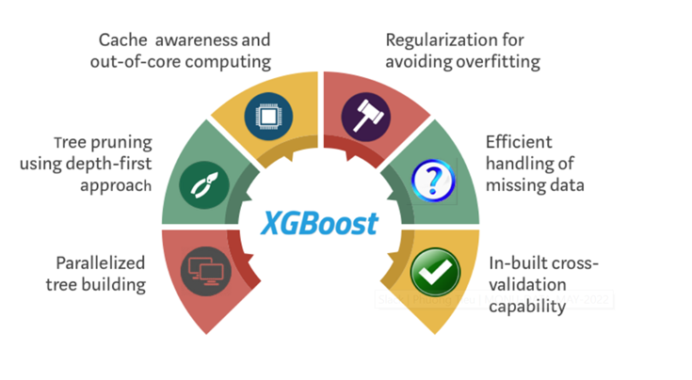
XGBOOST

Slide 9
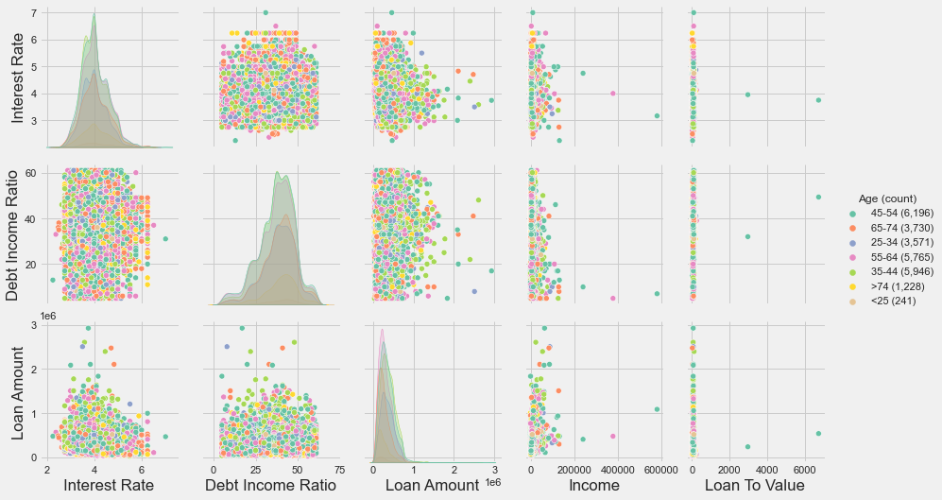
Data Analysis
DTI ratio vs Interest Rate
A2: DTI ratio & Interest Rate have strong correlation
Loan amount vs DTI & Interest Rate
A3: Interest Rate & Loan Amount have strong correlation;
B3: Loan Amount & DTI Ratio have strong correlation

Slide 10
Visualisation Process
Web Page
Front end
Back end
HTML
CSS
JS
PYTHON
SQLITE DATABASE
Data Engineering
Jquery/Echart
App.py
Flask
Data Imputing
Ajax
Data Cleaning
ML Models
unit.py

Slide 11
Conclusion
02
03
01
Selecting data with right sample size
Selection of Machine Learning Algorithm
Data Engineering in particular feature selection

Slide 12

THANKS!
https://mlforloan.herokuapp.com/

